Slide 1
Haptic-Force Feedback Glove
Joseph Bentivenga
Luka Lipovac
Varouzan Knouni

Slide 2
Electrical Engineering Aspect
Tracking of hand and finger motions
Game development engine
Development of platform between game engine and glove resources:
Force feedback resources
Cutaneous feedback resources

Slide 3
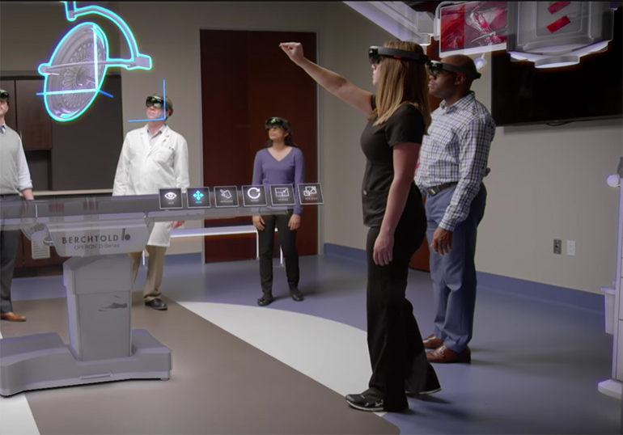

Haptic-Force Feedback Glove

Slide 4
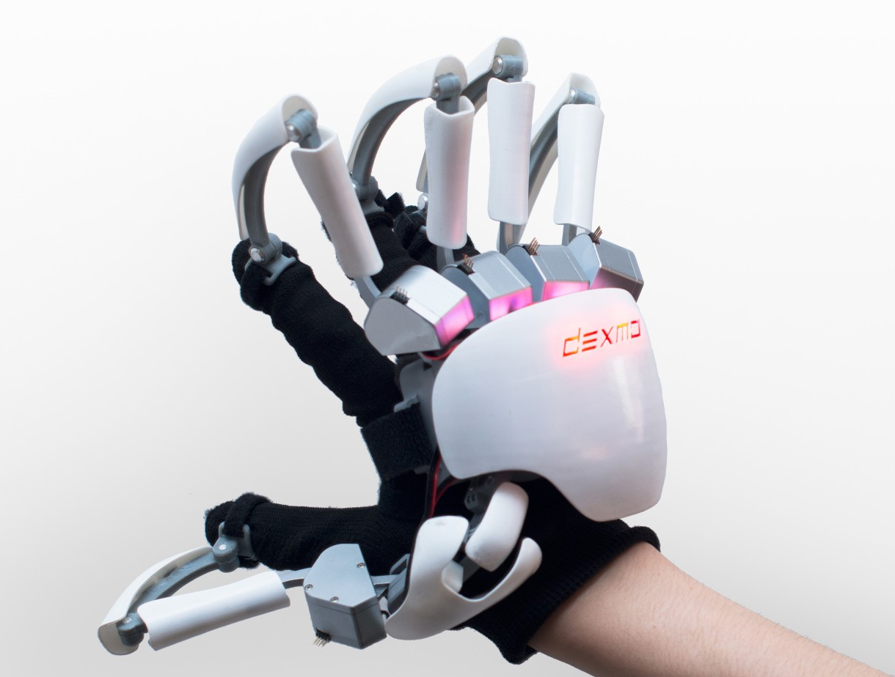
Current Solutions
Dexmo Force Feedback Glove

Slide 5
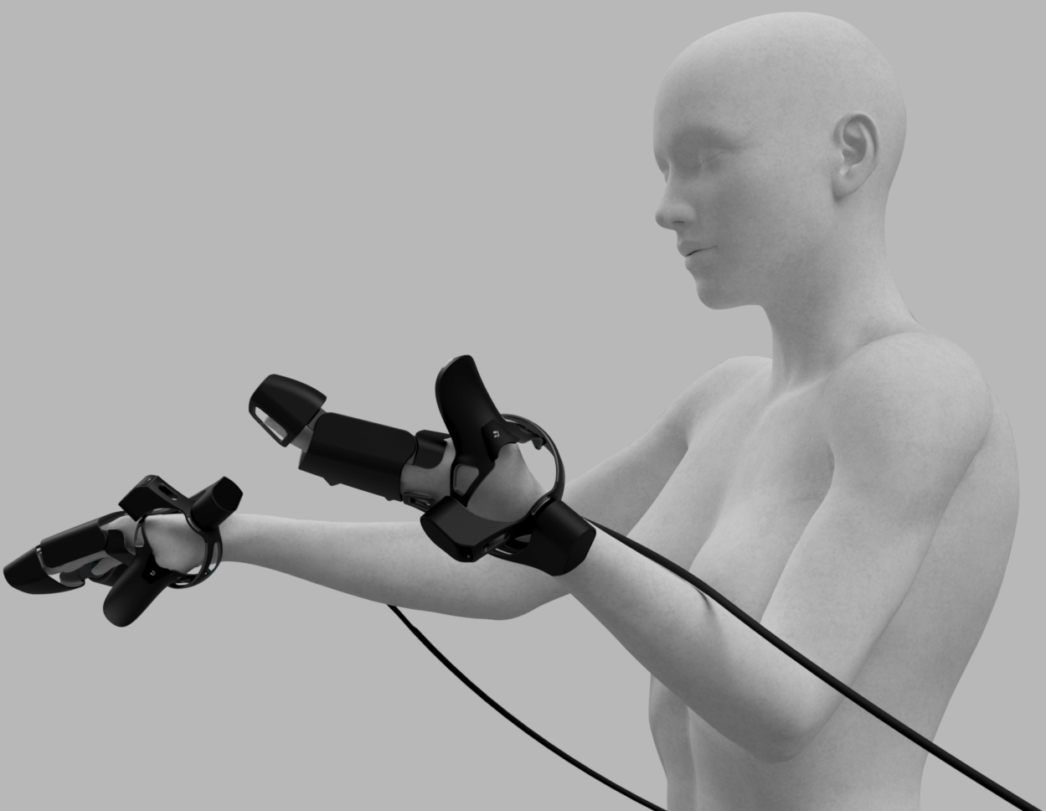
Current Solutions
EXOS Haptic VR Exoskeleton Glove
Notes:
EXOEXOS Haptic VR Exoskeleton Glove
S Haptic VR Exoskeleton Glove

Slide 6
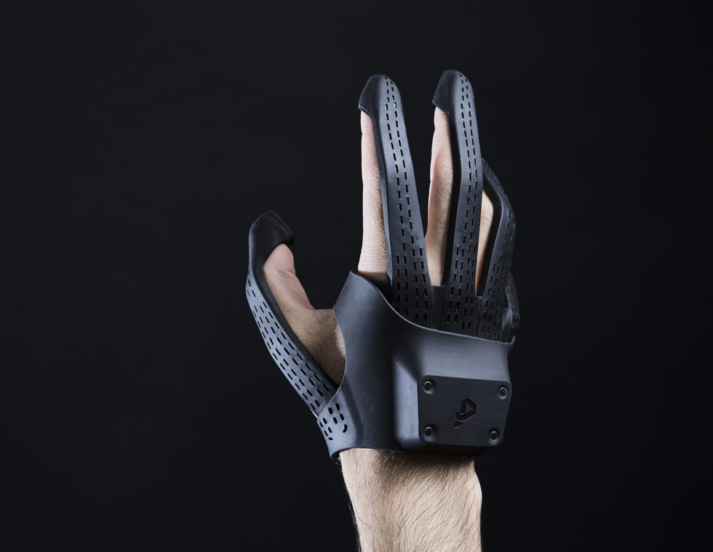
Current Solutions
Plexus VR Glove

Slide 7
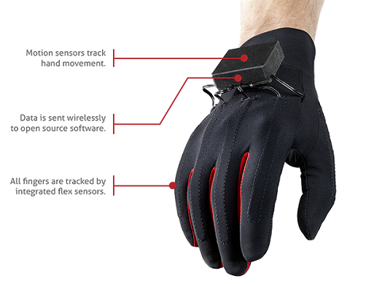
Current Solutions
Magnus Vr Glove

Slide 8
Our Haptic-Force Feedback Glove
Primary Features:
Non-intrusive
Portable
Realistic Feedback
Full positional tracking of hands

Slide 9
Tracking

Slide 10
Tracking
Current methods:
Accelerometers - integration of accelerometer data to get relative position
Decoders - strings or wires as part of exoskeleton
Cameras - hand recognition
Our Solution:
HTC Vive tracker for positional tracking
IMU for finger tracking

Slide 11
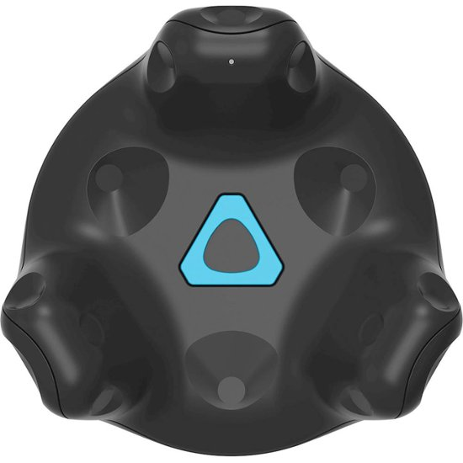
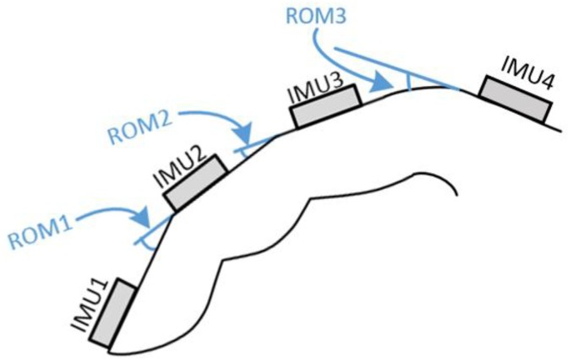
Tracking
Current methods:
Accelerometers - integration of accelerometer data to get relative position
Decoders - strings or wires as part of exoskeleton
Cameras - hand recognition
Our Solution:
HTC Vive tracker for positional tracking
IMU for finger tracking

Slide 12
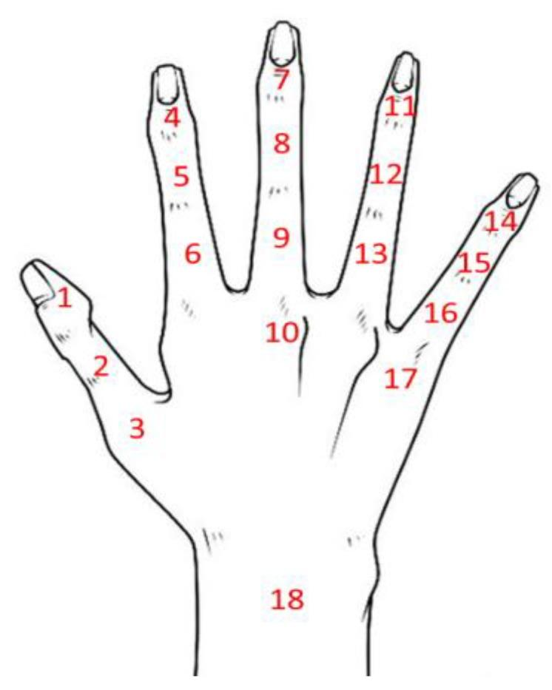
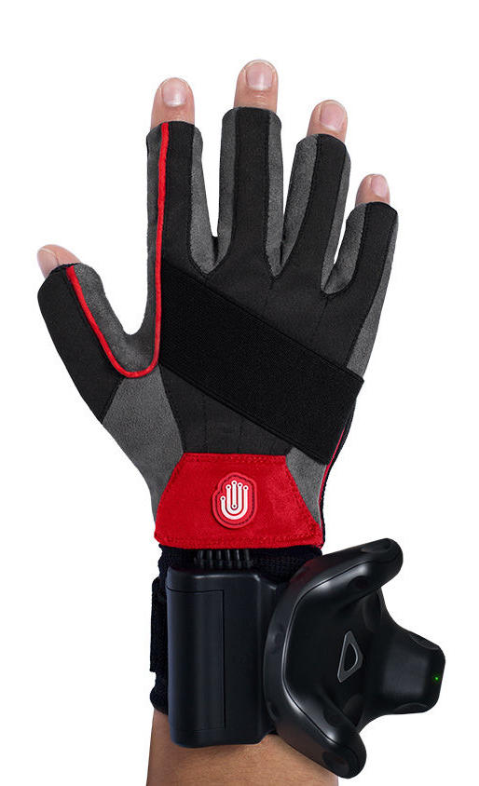
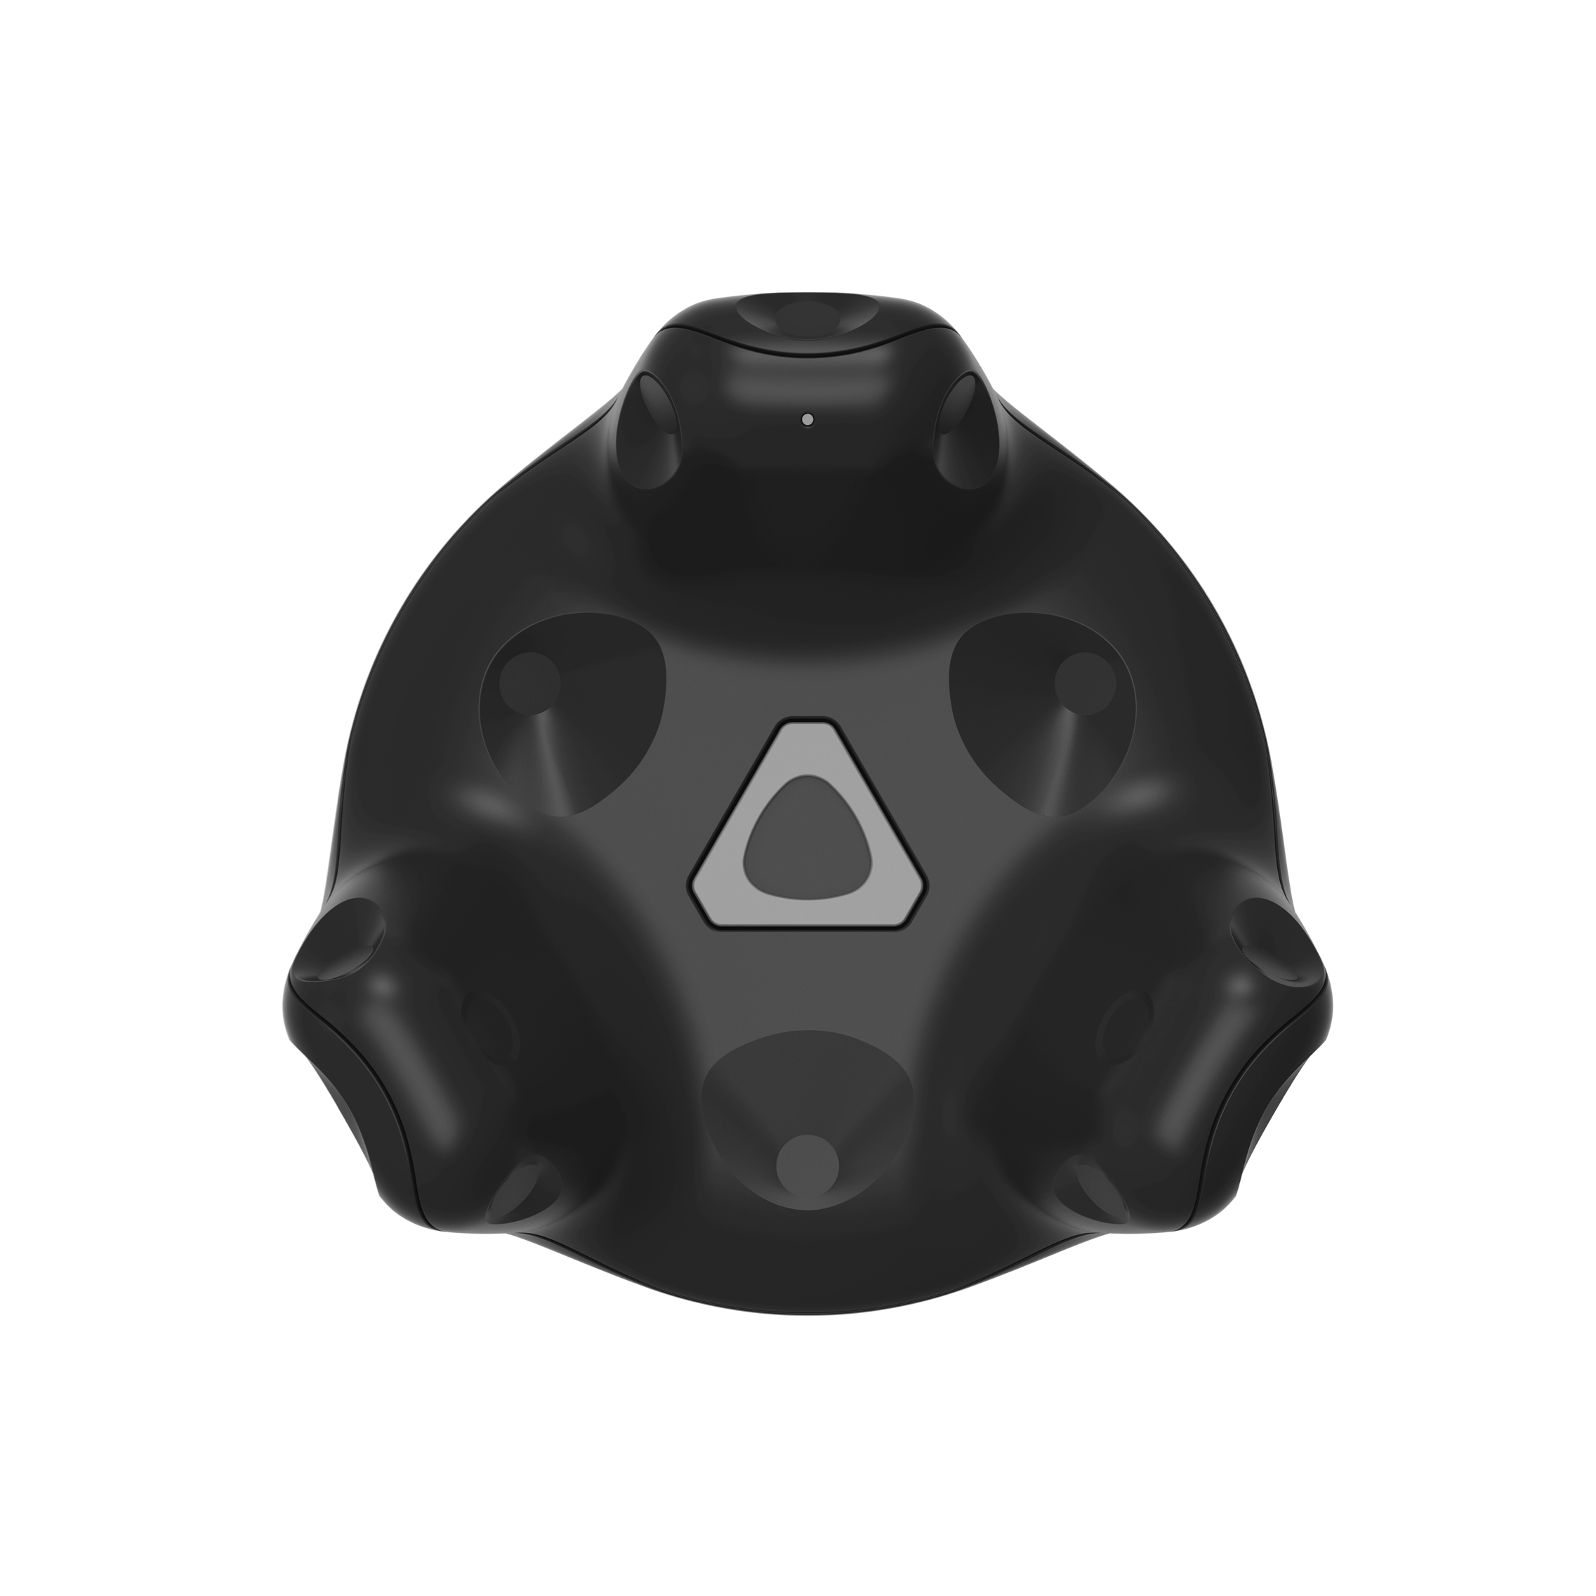
[Left]: IMU (Inertial Measurement Unit; Accelerometer + Gyro) placement on users Hand
[Right]: Vive Tracker on Noitom Hi5 VR Glove

Slide 13
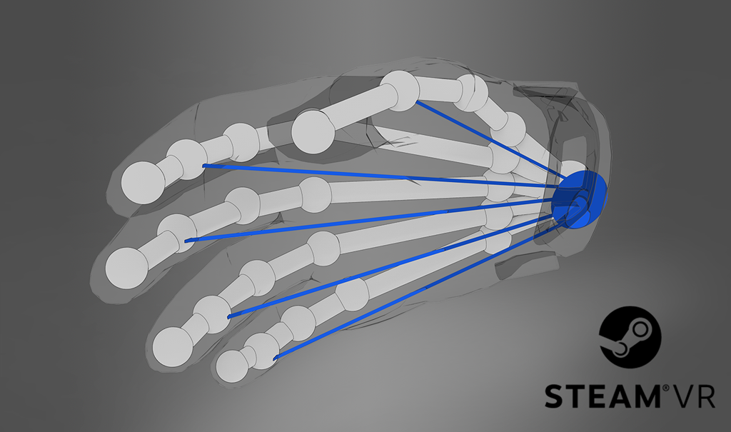
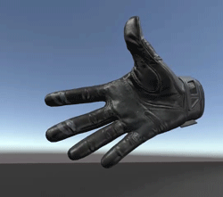
Mapping IMU Data to Unity Game Engine

Slide 14
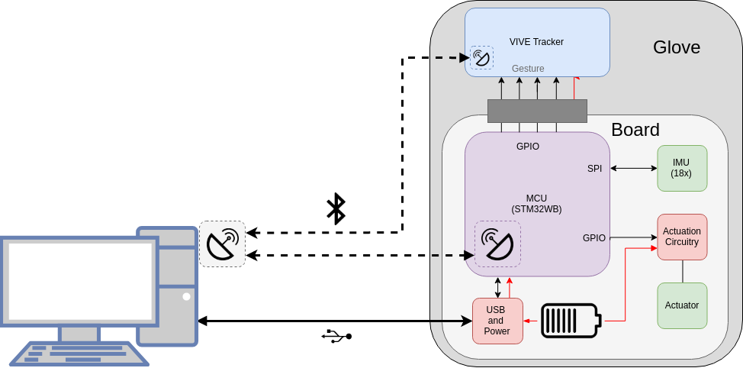
System Block diagram

Slide 15
Feedback

Slide 16
Feedback
Tactile object detection is a two step process:
Cutaneous Feedback (Skin Contact)
Kinesthetic Feedback (Musculoskeletal Resistance)

Slide 17

Cutaneous
Primarily achieved through haptic actuators:
Eccentric Rotary Mass
Linear Resonant Actuator
Piezo Disk

Slide 18
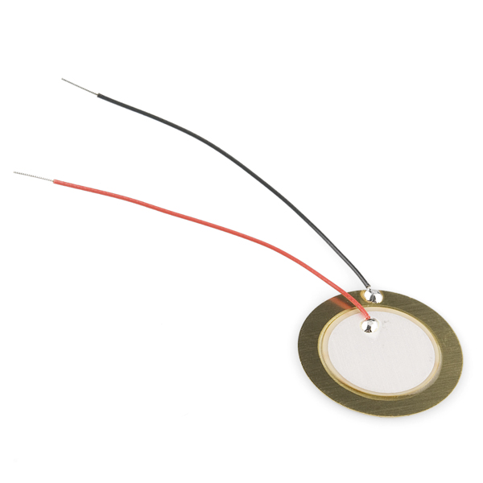
Cutaneous
Primarily achieved through haptic actuators:
Eccentric Rotary Mass
Linear Resonant Actuator
Piezo Disk

Slide 19
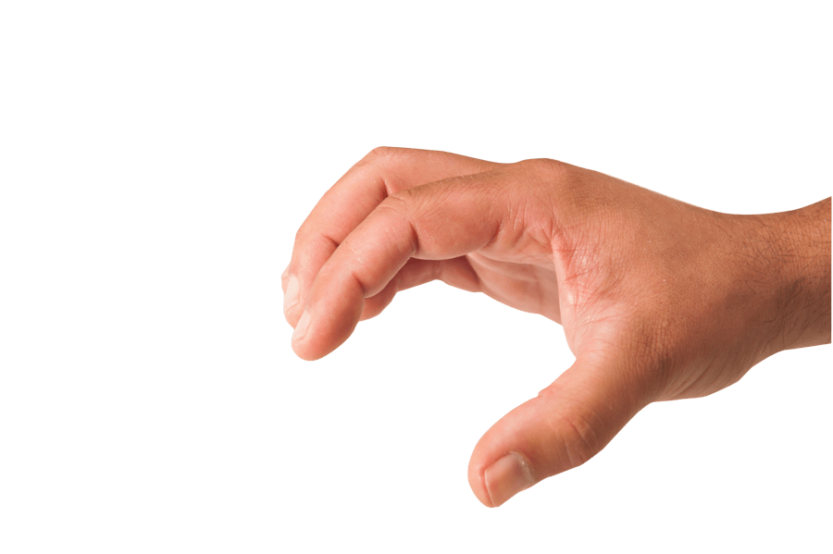
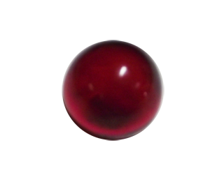
Kinesthetic

Slide 20
Kinesthetic

Slide 21
Kinesthetic

Slide 22
Kinesthetic Feedback Actuation Methods
 | Motor | Mechanical Clutch | Electroadhesive Clutch
Output Force | Continuous | Discrete | Discrete
Speed | Fast | Slow | Very Fast
Weight | Heavy | Heavy | Light
Power Consumption | High | Low | Ultra Low

Slide 23
Kinesthetic Feedback Actuation Methods
 | Motor | Mechanical Clutch | Electroadhesive Clutch
Output Force | Continuous | Discrete | Discrete
Speed | Fast | Slow | Very Fast
Weight | Heavy | Heavy | Light
Power Consumption | High | Low | Ultra Low

Slide 24
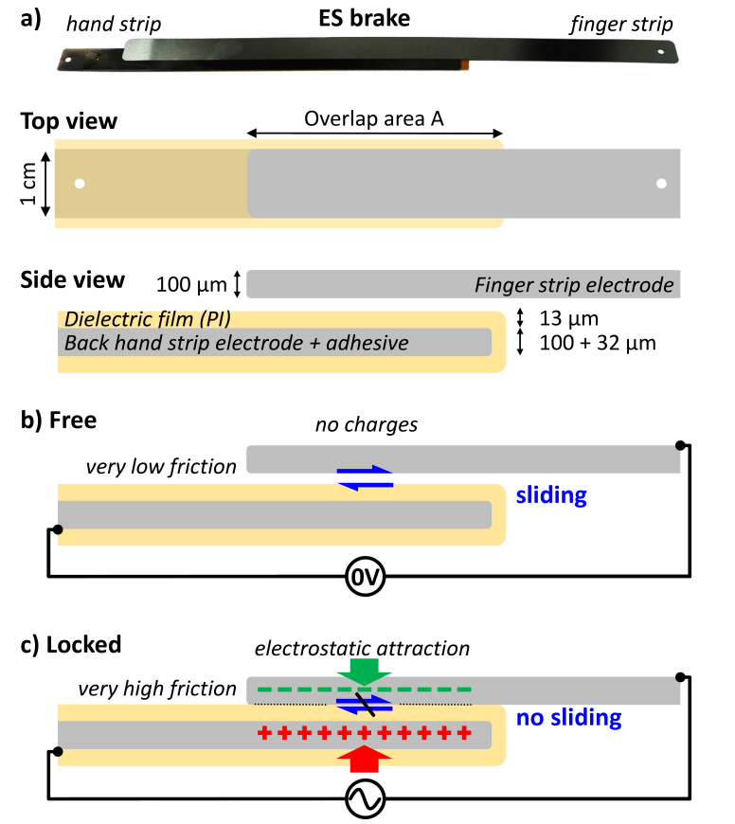
Electro Adhesive Clutch

Slide 25
Piezo Disk
Electro Adhesive Clutch Mounting with Piezo Disk

Slide 26
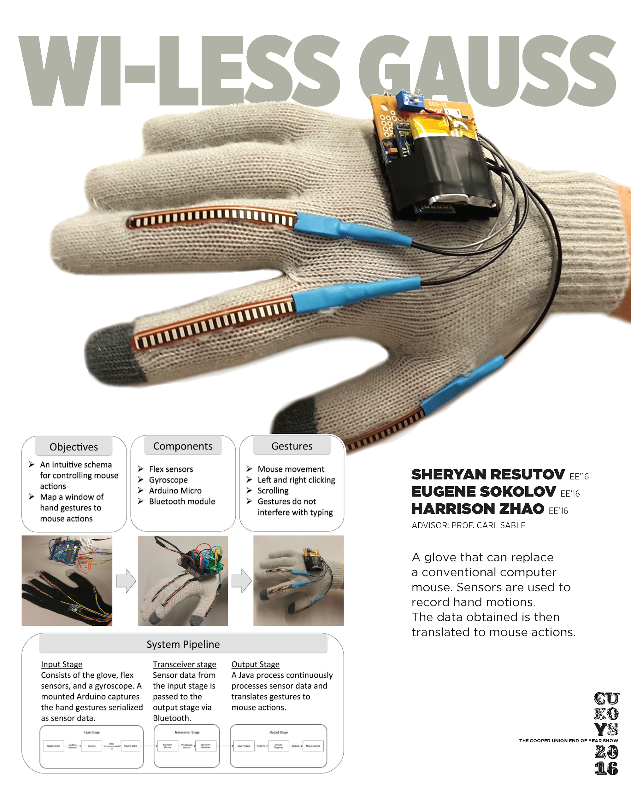
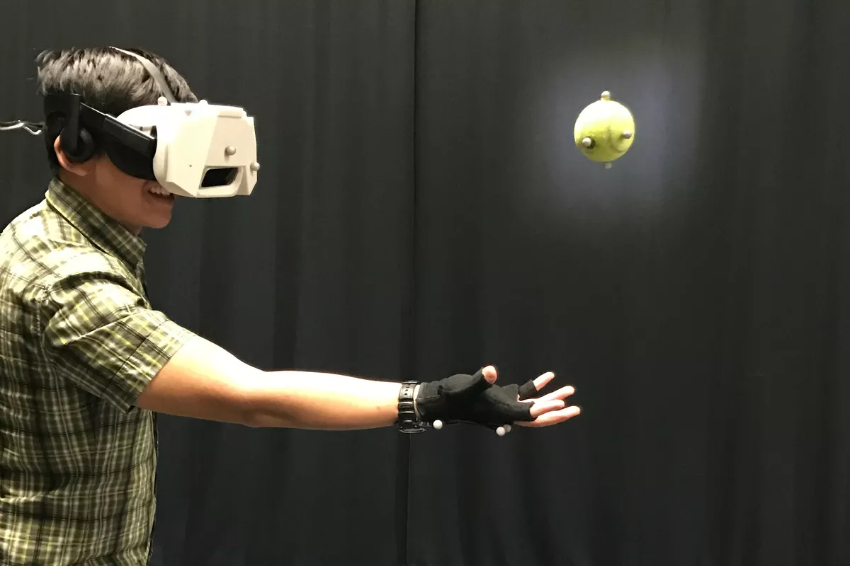
Use Cases

